Slide 1
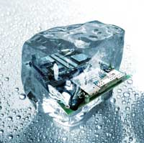
Lua Wireshark Dissectors
So easy, so useful
Kristoffel Pirard
July 1st 2014

Slide 2
Overview
Why and when
Dissector architecture
Example dissector dissected
What wasn’t covered
Demo
Links

Slide 3
Overview
Why and when
Dissector architecture
Example dissector dissected
What wasn’t covered
Demo
Links

Slide 4
Why and when
Network packet decoding
Recorded session
Use case: new protocol, new implementations
Lua => no performance
< 100k packets, < 10MB recording

Slide 5
Overview
Why and when
Dissector architecture
Example dissector dissected
What wasn’t covered
Demo
Links

Slide 6
Dissector Architecture
Table-driven delegation
Key -> Dissector
Dissector -> Table
Notes:
Example: tcp_port
TODO: drawing!

Slide 7
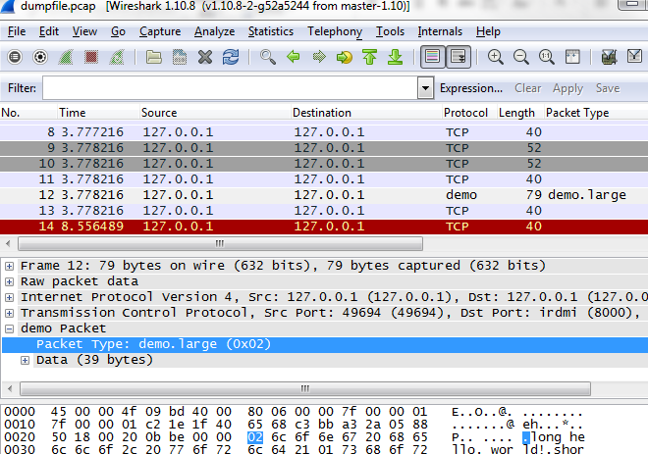
Dissector Architecture
dissector
table
dissector
2014
telnet
2
10
demo
23
http
8000
8080
ftp
2
Notes:
Your dissector gets hold of
vtbuffer
Packet info
Tree structure

Slide 8
Dissector Architecture
Cascading dissector table
demo.short
2014
telnet
0x01
2
10
demo
0x02
23
8000
demo.large
8080
ftp
2

Slide 9
Dissector Architecture
Plugins
Statically linked (C)
Dynamic (.so, .dll)
Python (broken on current windows version)
Lua

Slide 10
Dissector Architecture
Entry points (link)
<personal config dir>/init.lua
Wireshark/plugins
cmdline: -X lua_script:xxx.lua

Slide 11
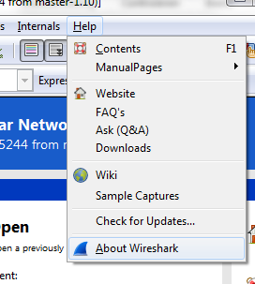
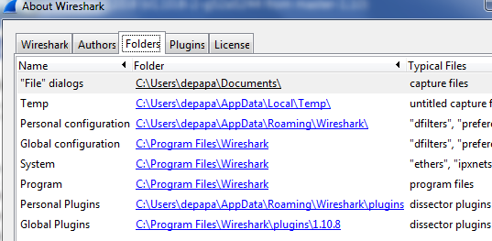
Dissector Architecture
Finding your entry point

Slide 12
Overview
Why and when
Dissector architecture
Example dissector dissected
What wasn’t covered
Demo
Links

Slide 13


Example dissector dissected
Declare the protocol
Declare the dissector function
Bind to a dissector table

Slide 14
Example dissector dissected
Declare the fields
Enumeration fields:

Slide 15
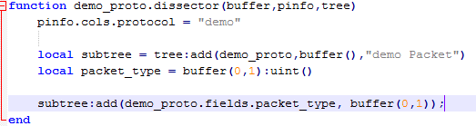
Example dissector dissected
Populate the tree and info

Slide 16

Example dissector dissected
Delegating to sub-protocols:
Declare a dissector table
Dispatch in dissector function
Register sub-protocols

Slide 17
Overview
Why and when
Dissector architecture
Example dissector dissected
What wasn’t covered
Demo
Links

Slide 18
What wasn’t covered
Loopback on windows: rawcap needed
Endianness, bitfields
Conversations, multi-packet messages, …

Slide 19
Overview
Why and when
Dissector architecture
Example dissector dissected
What wasn’t covered
Demo
Links

Slide 20
Demo
… all goes well

Slide 21
Links
Getting started:
http://wiki.wireshark.org/Lua
Details
http://ask.wireshark.org/
http://stackoverflow.com/
Demo: https://github.com/xtofl/wiresharkdemo

Slide 22




www.sioux.eu

